Slide 1
PCA for Feature Reduction
Group 3:
Preston Buscay, Johannes Djupesland, Tore Gude, Cameron Louis Penne, Nicole Quattrini

Slide 2
Overview
Introduction
Quick return to PCA
Significance Testing
Example
Pros/Cons

Slide 3
Introduction
Why do we need feature reduction?
Improve model performance
What is feature reduction by PCA?
Filtering method: only look at $X$
Filtering method: only look at 𝑋
Reduce computational cost
Guiding feature engineering
Reduce dimensionality by PCA
Analyze which features contribute to selected PCs
Notes:
Improve model performance:
Simplifies the model, reducing noise, which again reduce risk of overfitting.
Enhances generalization by focusing on the most informative attributes
Reduce computational cost:
Guiding feature engineering:
Identify which features are most informativee, guiding the selection of features for further analysis or model building

Slide 4
PCA
Data Standardisation
Normalisation of the features to have where mean = 0 and st.dev = 1
Covariance Matrix
Identification of covariance within the X matrix
Eigen-decomposition
Based on covariance matrix: linear transformation into eigenvectors & eigenvalues
Identification of potential components that capture the most variance.
Select PCs
Quantification of the variance explained by new features

Slide 5
Significance test
Determine which variables are important for each of the principal components
Based on an uncertainty estimates computed from the PCA loadings
PCA loadings are computed from:
Full dataset
Cross-validated dataset
Source: F. Westad, M. Hersleth, P. Lea, and H. Martens, ‘Variable selection in PCA in sensory descriptive and consumer data’, Food Quality and Preference, vol. 14, no. 5, pp. 463–472, Jul. 2003, doi: 10.1016/S0950-3293(03)00015-6.

Slide 6
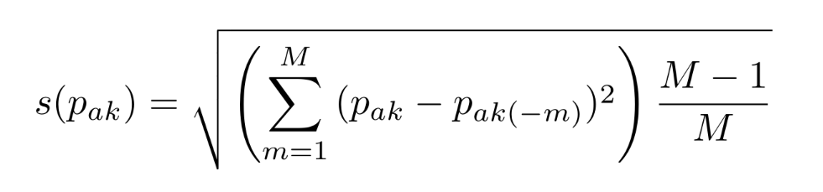
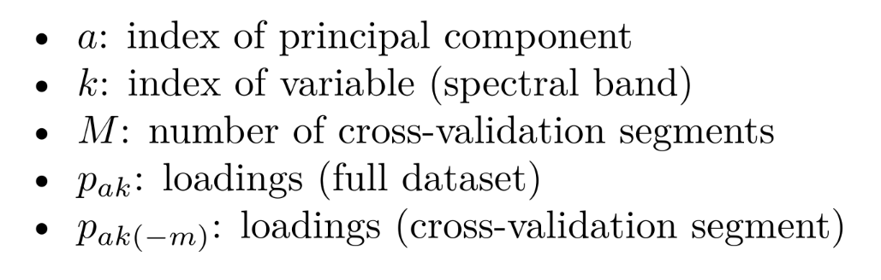
Significance test

Slide 7
Significance test
Compute difference, square, and sum across all cross-validation folds

Slide 8

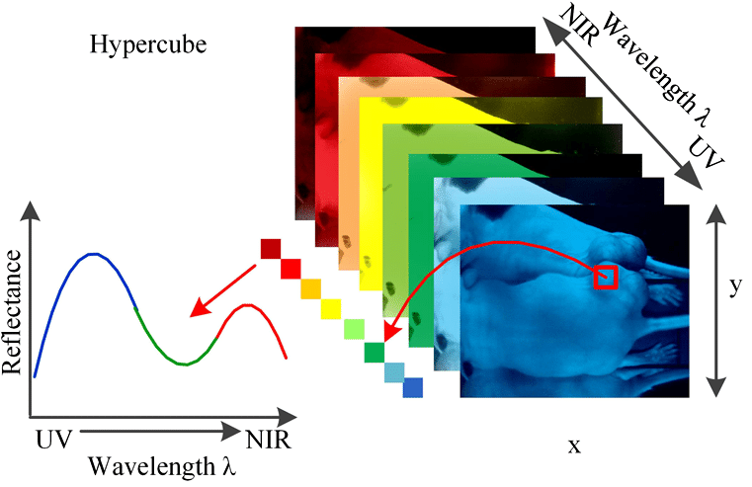
Example - Data
300k+ samples: pixels
115 variables: bands 400nm to 800nm

Slide 9
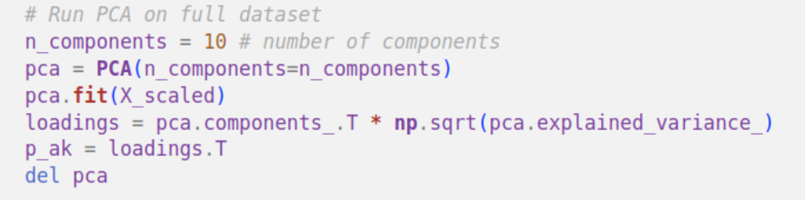
Example – PCA

Slide 10
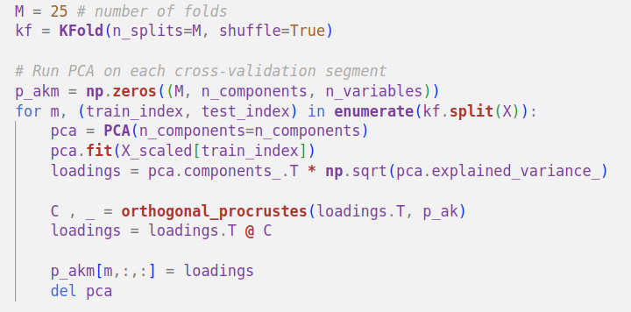
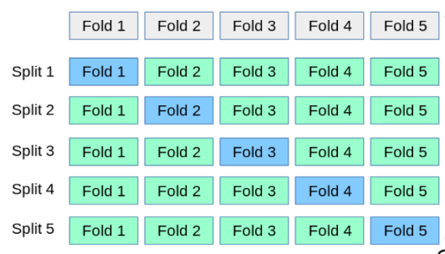
Example – Running PCA

Slide 11
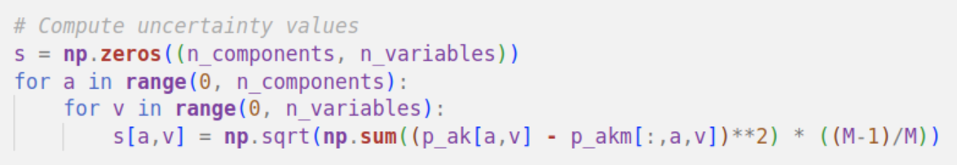
Example – Uncertainty Variance

Slide 12
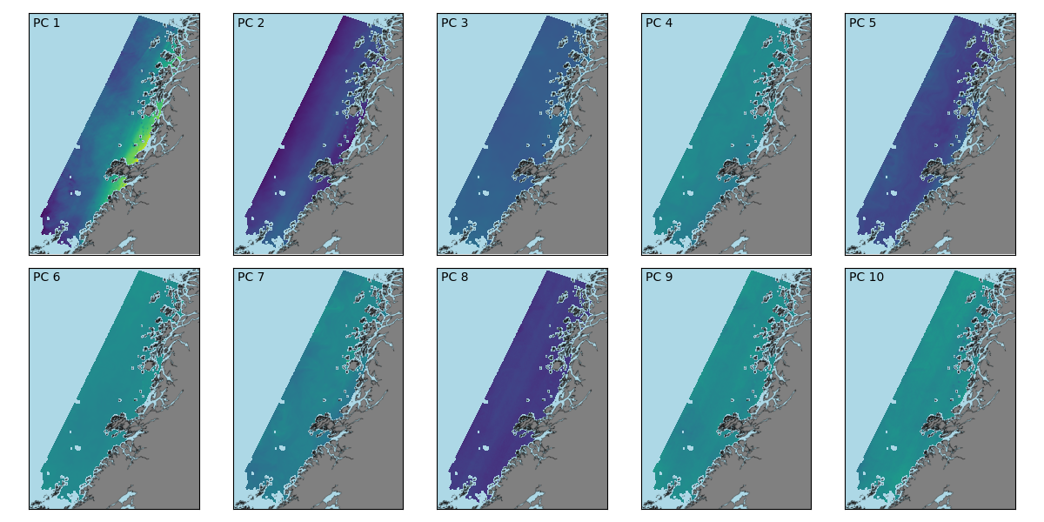
Example – Principal Components

Slide 13
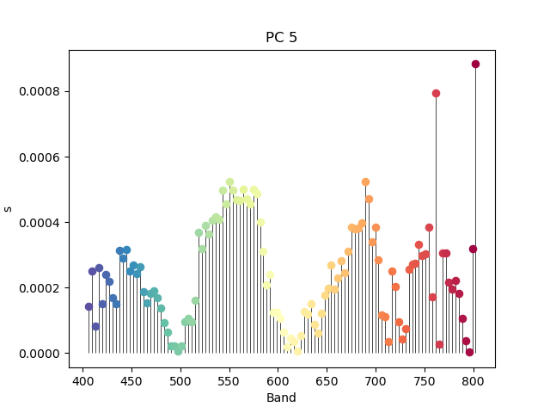
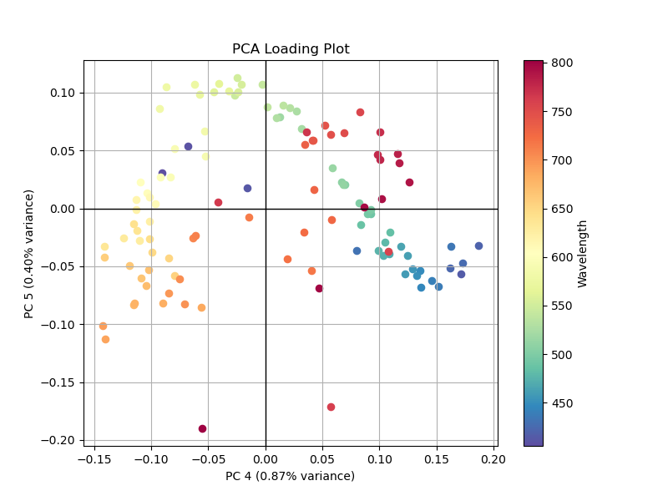
Example – Uncertainty Variance

Slide 14
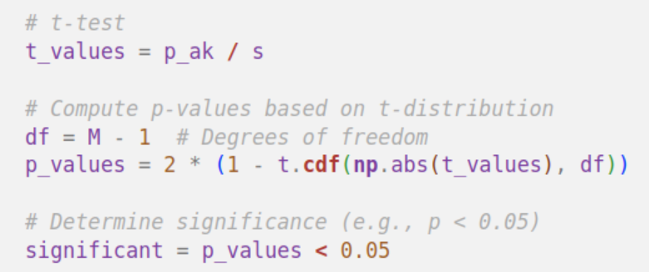
Example – Significance Test
Modified t-test
P_ak / s(p_ak) = 0

Slide 15
Pros & Cons
Pros
Cons
Reduces dimensionality
Reduces number of dimensions in a training set
De-noise data
PCA is not robust against outliers
Assumes linear relationship

